Slide 1


Evaluation of Supernovae Astrophysical Parameters by Using Machine Learning on Laser Interferometric Data
Dymetris Ramirez, Dr. Manuel Morales, Dr. Michele Zanolin, Michael Benjamin, and Colter Richardson

Slide 2



Table of Contents
What are Core-Collapse Supernovae
What are Gravitational Waves
What Astrophysical Features come from Gravitational Waves
What is coherent WaveBurst
What is Machine Learning
How are Gravitational Wave Features identified

Slide 3
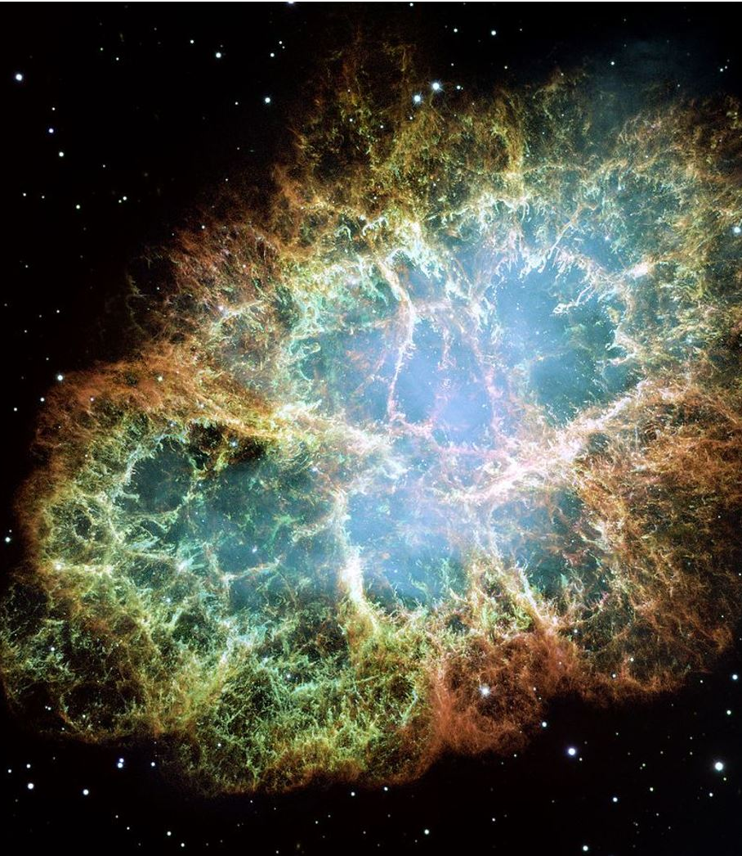
Core-Collapse Supernovae (CCSNe)
A CCSN occurs when a massive star (being larger than 8 times the mass of our sun) ends its lifecycle [when the iron core exceeds 1.4 solar masses]
At this point the core collapses and the stellar atmosphere begins to fall onto its new compacted core, where it bounces off the new proto-neutron star creating a shockwave
As the shockwave propagates through the infalling material it may eventually stall
This stalled shock may eventually be revived by neutrino pressure

Slide 4
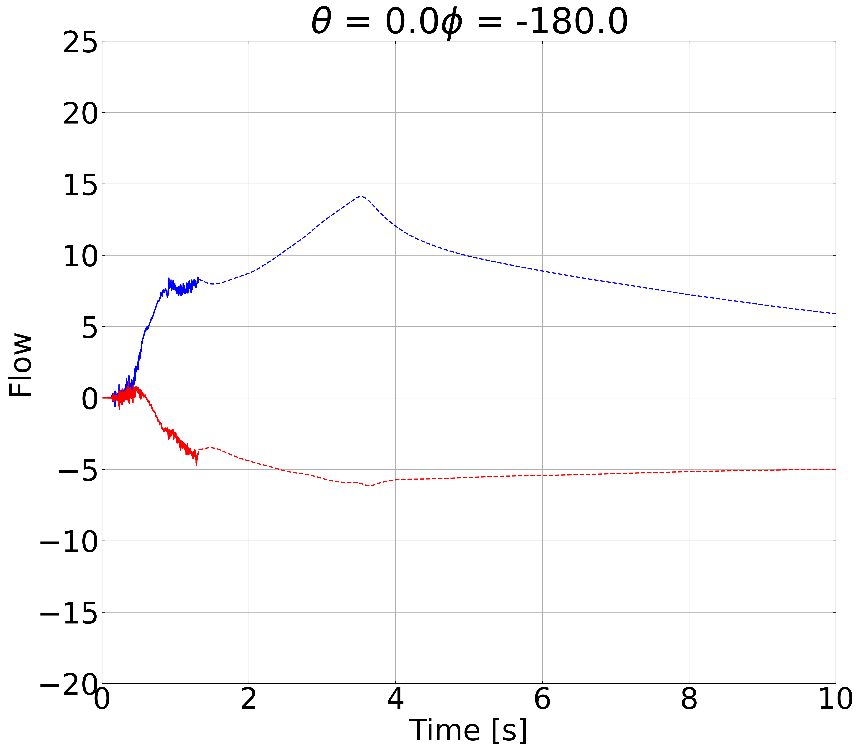
Gravitational Waves (GWs)
The term Gravitational Waves (GWs) describes fluxuations in the properties of space-time produced by astrophysical sources such as Core-Collapsed Supernovae and have been detected from so call merger events
As we have yet to detect GWs from CCSNe, data analysists from the LIGO/Virgo/Kagra Collaboration’s supernova working group, focuses on preliminary analysis of simulated events
My research on GWs focuses on detecting astrophysical features in these events, in order to better prepare the Collaboration's response for the next galactic supernova

Slide 5
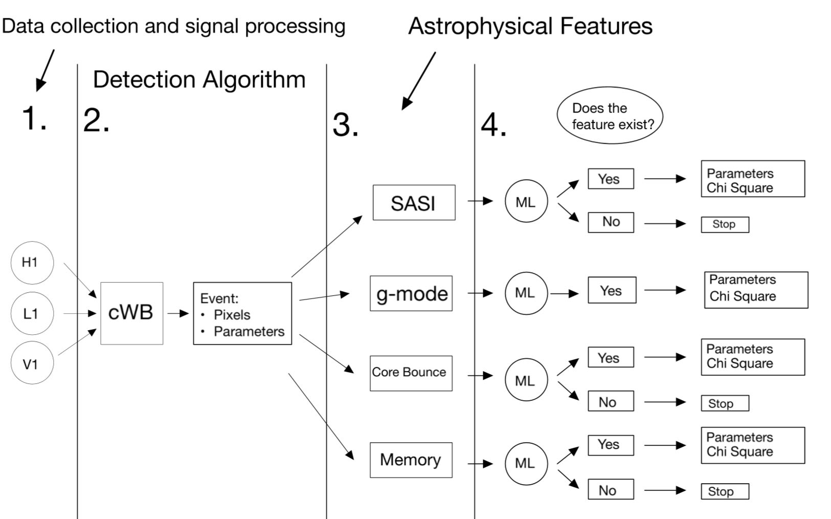
Astrophysical Features
The LVK’s interferometers are Hanford (H1), Livingston (L1), Virgo (V1), and Kagra
  These detectors record the warping of space-time by measuring the intensity of light in the detectors

Slide 6

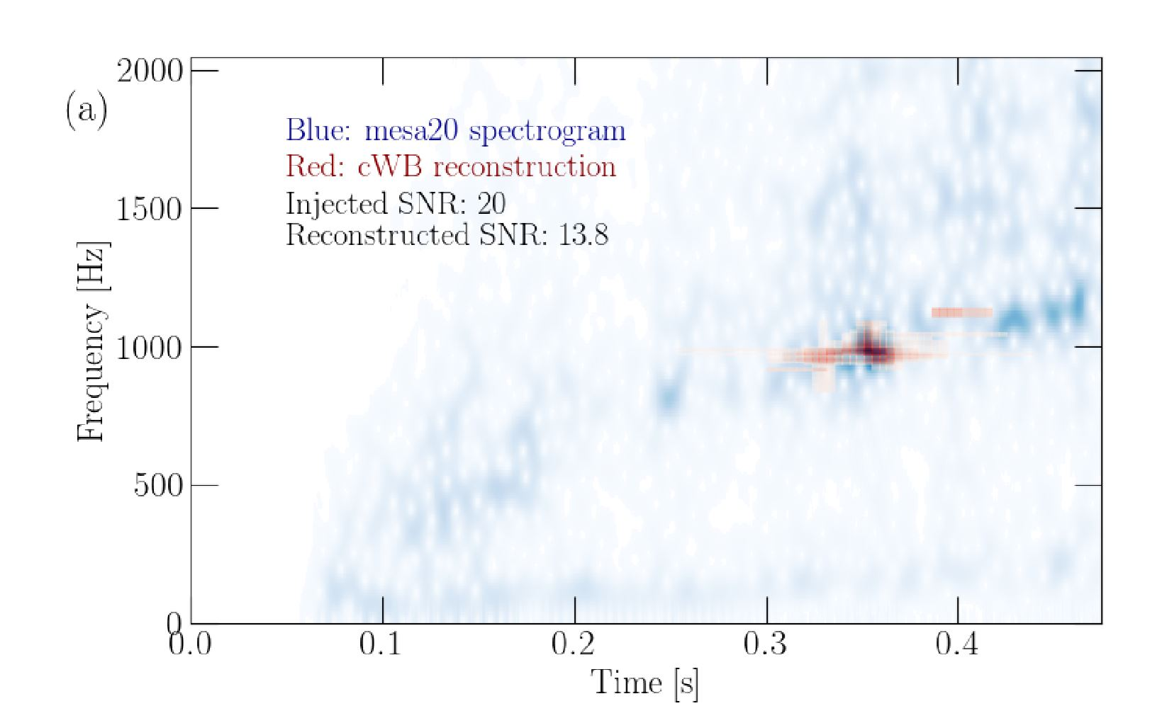
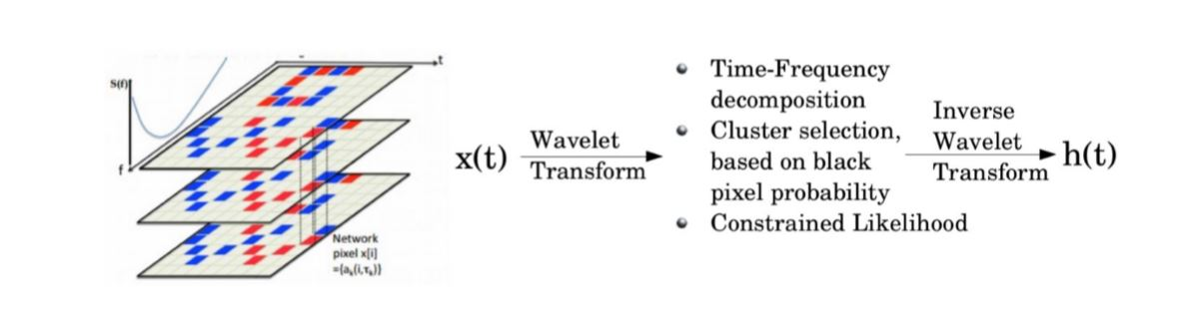
coherent WaveBurst (cWB)
coherent WaveBurst (cWB) is a data-analysis tool to search for a broad range of gravitational-wave (GW) transients
The pipeline identifies coincident events in the GW data from earth-based interferometric detectors and reconstructs the gravitational wave signal by using a constrained maximum likelihood approach
The figure on the left shows the reconstruction of Gravitational Waves from a CCSNe, in cWB after the performance of the Wavelet Transform
The figure on the right shows the process cWB uses to turn data from time series into time frequency by decomposition using the Wavelet Transform
The figure shows the Oco+18 mesa20 supernova waveform that contains an overlay of cWB reconstruction

Slide 7
Machine Learning
By constructing a trained machine in this project, the production of the pixel spectrogram is the data that is then passed through machine learning (to undergo the three methods of training, testing, and production) to see if speciﬁc features exist
Once the GWs are conﬁgured through cWB, machine learning is then operated again by inputting a bunch of events (that either contain a feature or don’t) into a computer program and teaching it which events show existence
The ﬁrst step of this method is called the training phase, in which we tune some interval parameters of the machine learning algorithm to depict speciﬁc values in the data
The next step for machine learning is to run the testing phase in which features, that already have a known outcome, are inputted to see if the machine has been trained correctly
This step will allow for corrections to be made to the machine if it gives any false information about existing or non-existing features
The ﬁnal phase of machine learning is the production, where raw data, that is collected from a CCSNe event, is inputted into machine learning to see if speciﬁc GW features exist

Slide 8
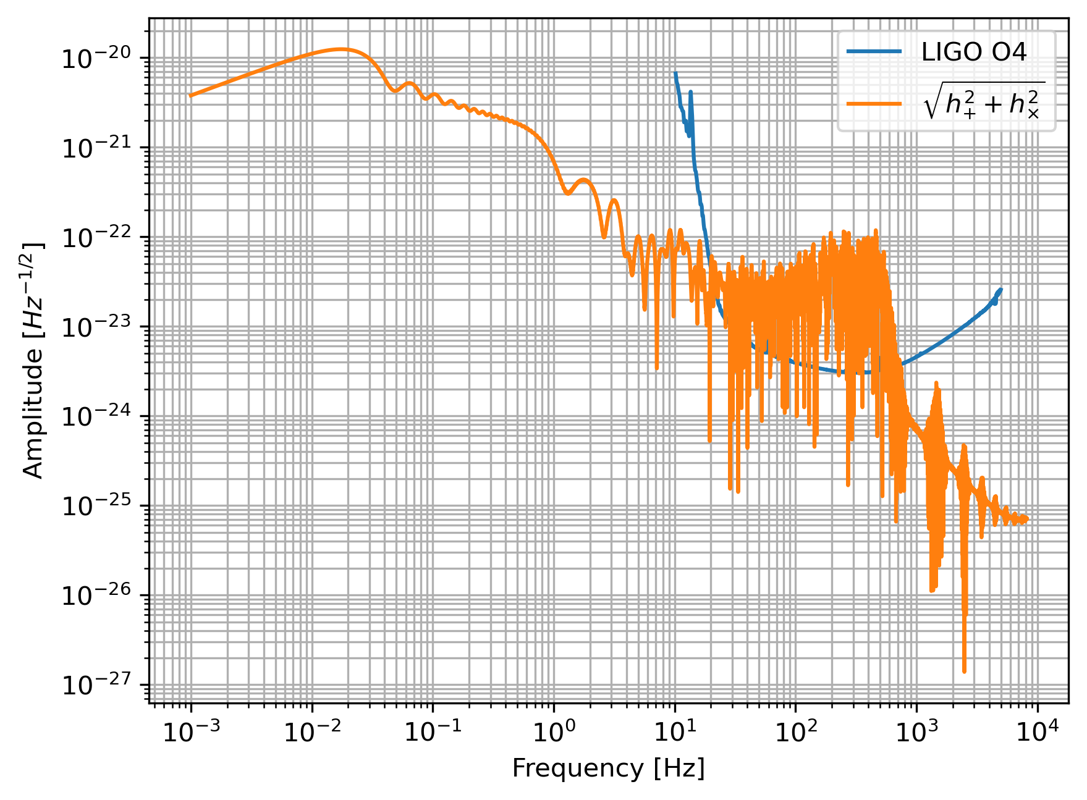
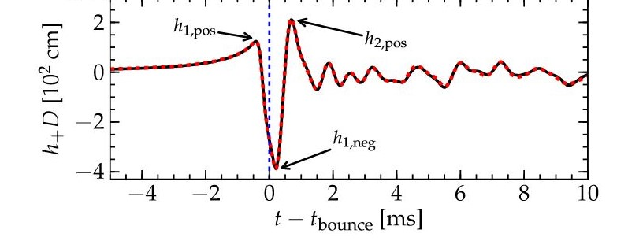
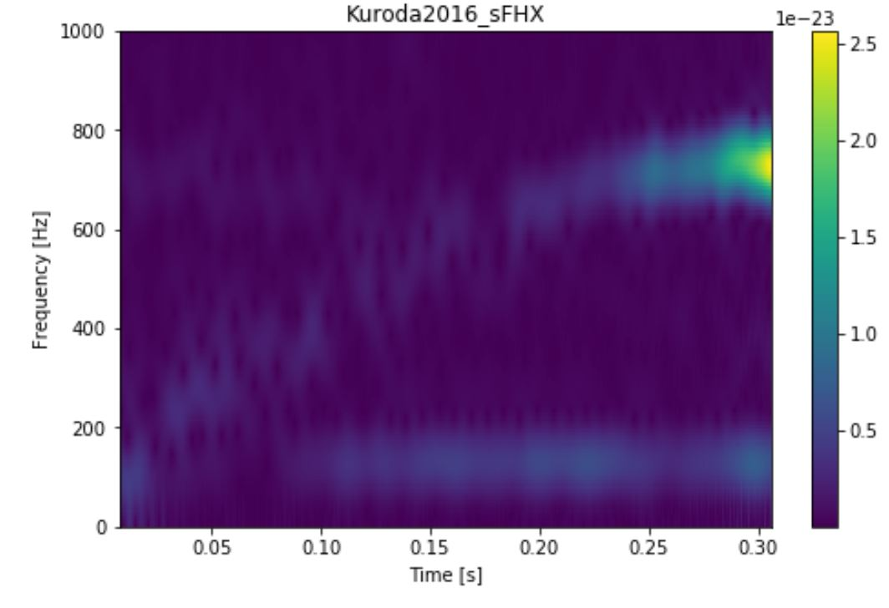
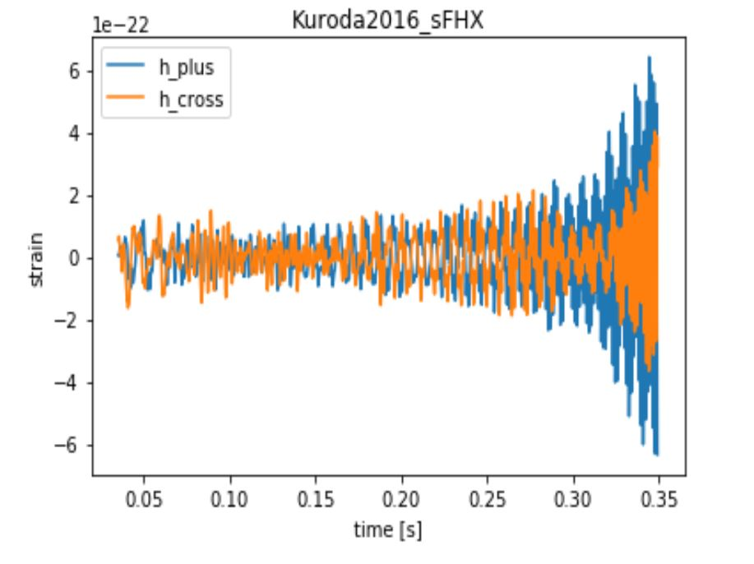
Frequency Strain Graph of GW for memory
Core Bounce
Spectrogram with SASI and g-mode
Time Series of SASI and g-mode

Slide 9
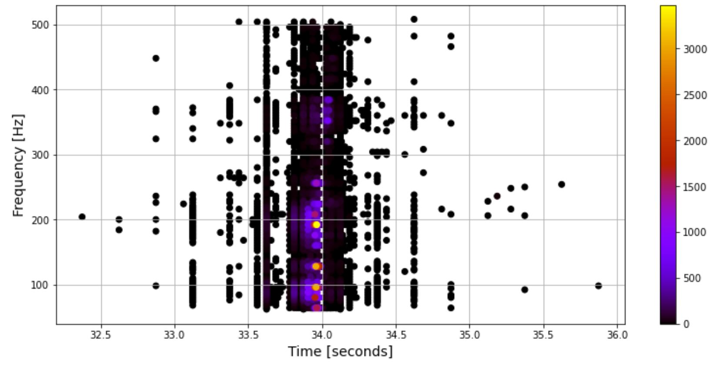
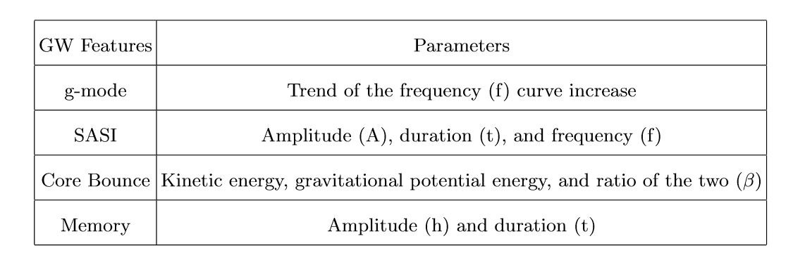

Slide 10
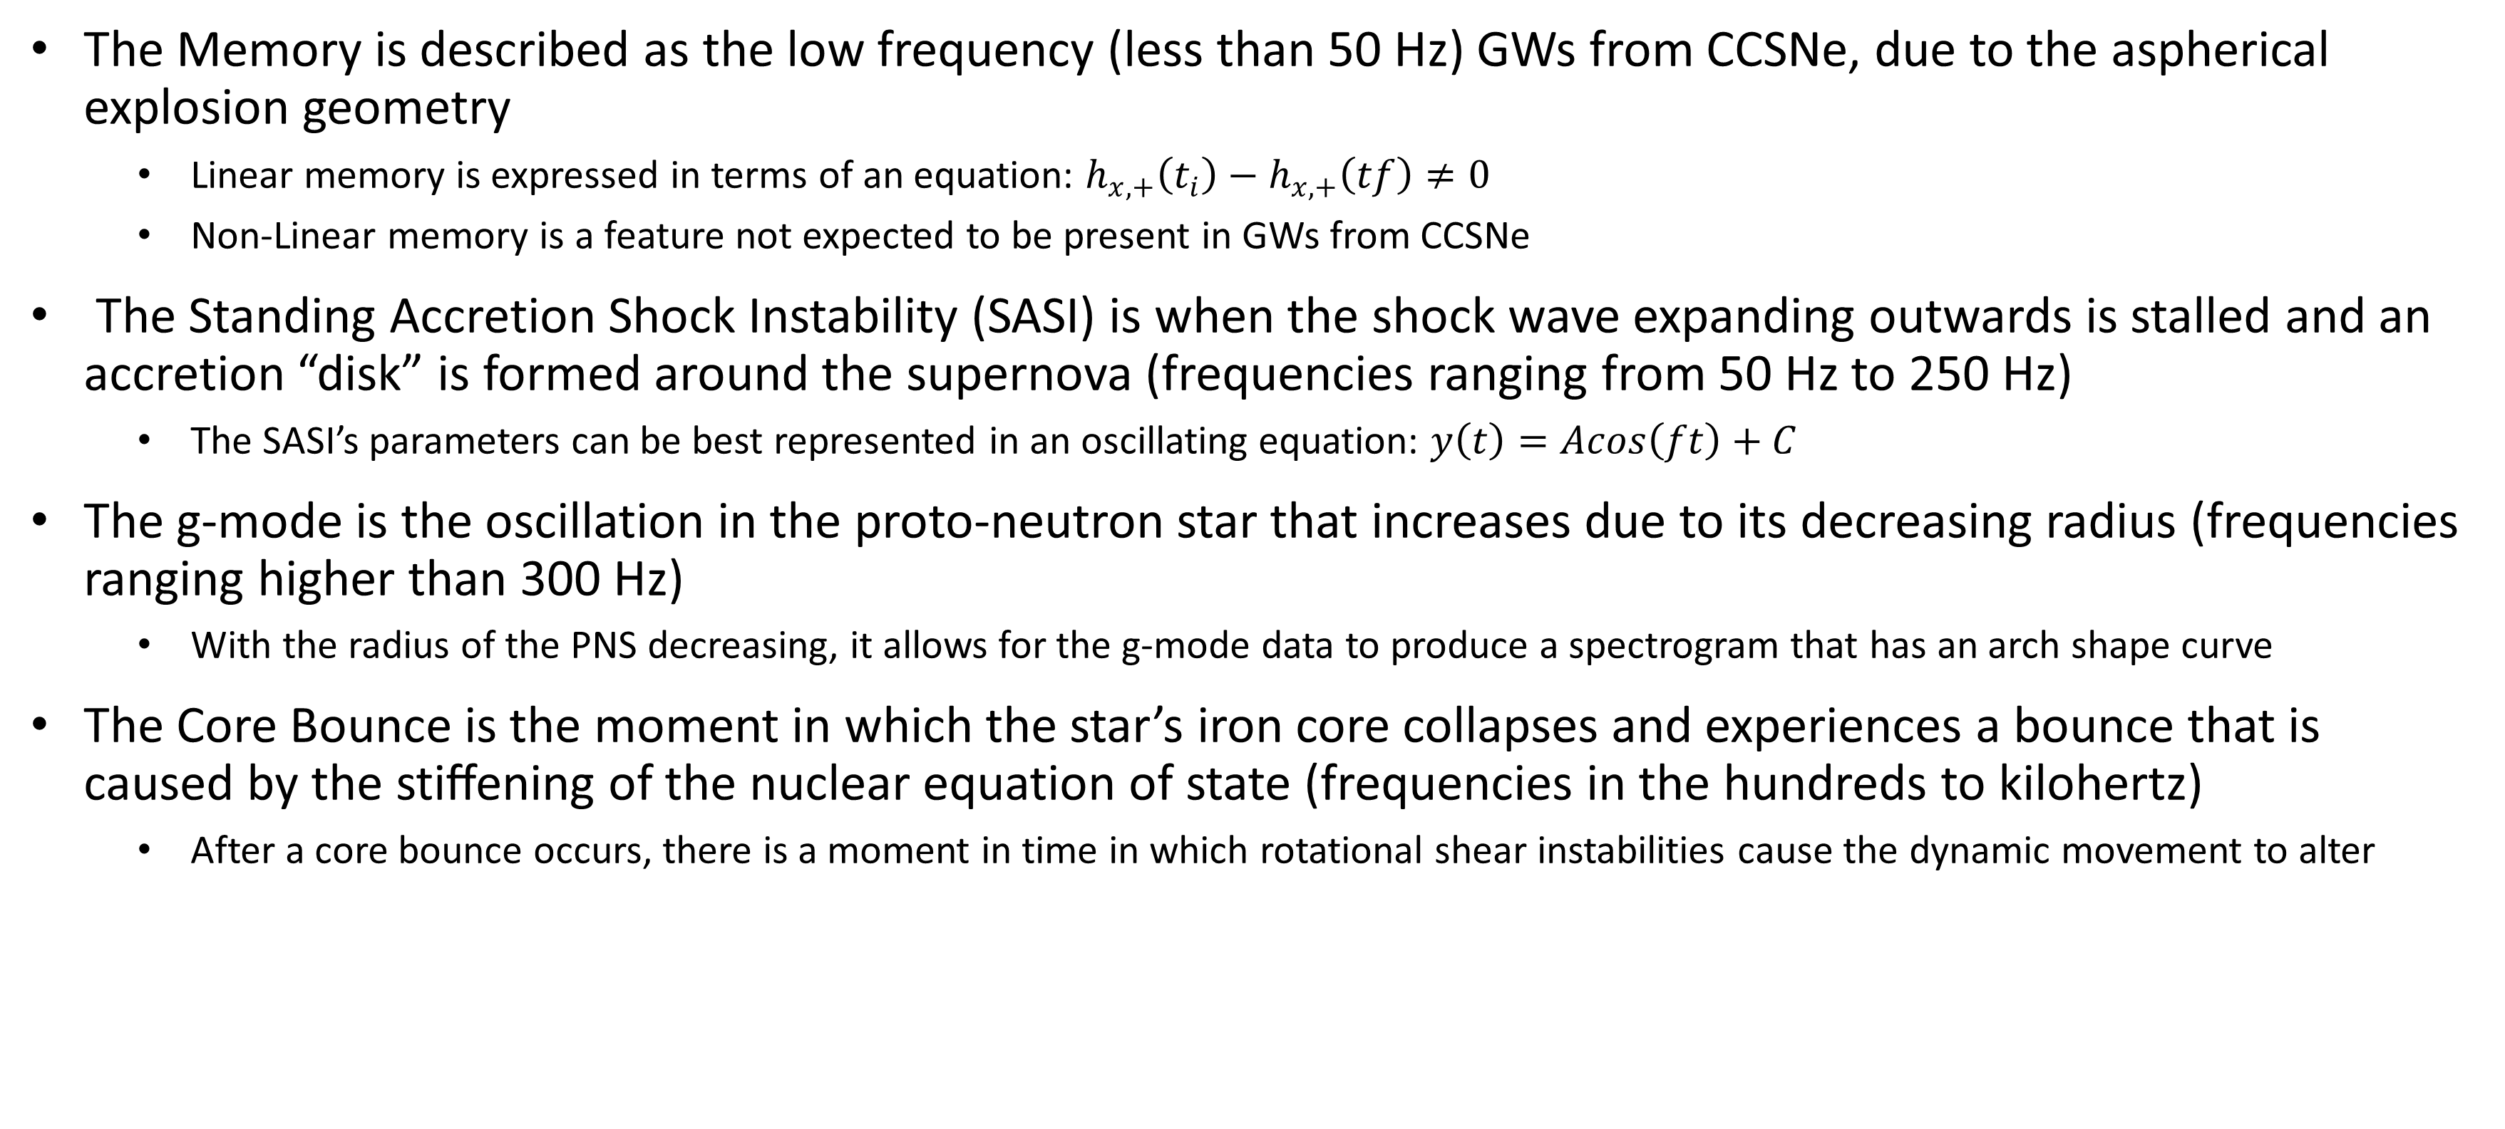
CCSN GW Features
The Memory is described as the low frequency (less than 50 Hz) GWs from CCSNe, due to the aspherical explosion geometry
  Linear memory is expressed in terms of an equation: $h_{x,+}\left(t_{i}\right)−h_{x,+}\left(tf\right)≠0$
  Non-Linear memory is a feature not expected to be present in GWs from CCSNe
The Standing Accretion Shock Instability (SASI) is when the shock wave expanding outwards is stalled and an accretion “disk” is formed around the supernova (frequencies ranging from 50 Hz to 250 Hz)
  The SASI’s parameters can be best represented in an oscillating equation: $y\left(t\right)=Acos\left(ft\right)+C$
The g-mode is the oscillation in the proto-neutron star that increases due to its decreasing radius (frequencies ranging higher than 300 Hz)
  With the radius of the PNS decreasing, it allows for the g-mode data to produce a spectrogram that has an arch shape curve
The Core Bounce is the moment in which the star’s iron core collapses and experiences a bounce that is caused by the stiﬀening of the nuclear equation of state (frequencies in the hundreds to kilohertz)
  After a core bounce occurs, there is a moment in time in which rotational shear instabilities cause the dynamic movement to alter

Slide 11
Conclusion
I have started learning how to use cWB to drop event pixels into graphs and separate the astrophysical parameters from them
My research is designed to create a machine that can be trained to evaluate GW events to see if astrophysical parameters exist using Convolutional Neural Networks

Slide 12
References
E. P. O’Connor and S. M. Couch, Astrophys. J. 865, 81960 (2018), arXiv:1807.07579
Crab nebula - a sn 1054 remnant, https://en.wikipedia.org/wiki/CrabNebula/media/File : CrabNebula.jpg. Accessed : 2/3/2021
M. J. Szczepanczyk, “Multimessenger astronomy with gravitational waves from core collapse supernovae,” Ph.D. dissertation, Dept. Phys. Astro., Embry-Riddle Aero., Daytona Beach, FL, 2018.
Richardson, C., Zanolin, M., Andresen, H., Szczepanczyk, M., Wongwathanarat,(2021). A.Modeling core-collapse supernovae gravitational wave memory in laser interferometric data
S. Klimenko, I. Yakushin , A. Mercer, G. Mitselmakher , Coherent method for detection of gravitational wave bursts, Class. Quantum Grav. 25, 114029 (2008)

Slide 13

Questions?

